Slide 1
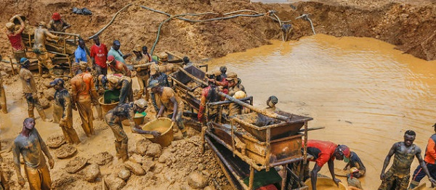
GROUP 5
The Menace of Small-Scale Illegal Mining in Ghana
1

Slide 2
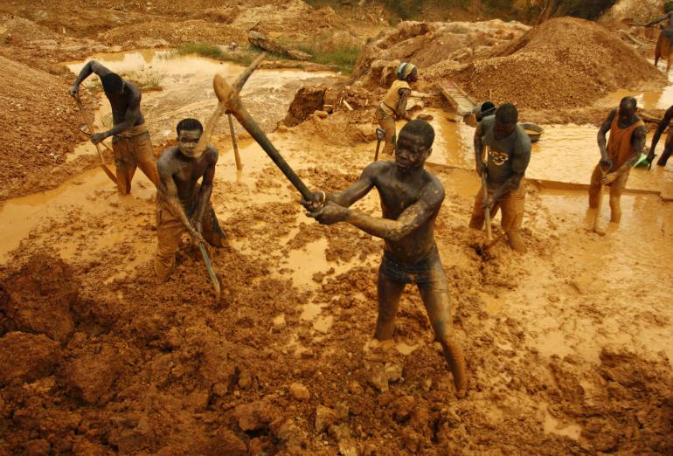
Introduction
Small-scale illegal mining, also known as galamsey, has become a significant problem in Ghana.
This presentation aims to highlight the negative impact of small-scale illegal mining and the challenges it poses..
Figure 1 People working at a galamsey mining site
2

Slide 3
Surface mining results in about
58%
and a substantial 45% loss of farmland within mining concessions in the western region of Ghana according to a study.
of deforestation activities
3

Slide 4




Impacts of Small-Scale Mining
Environmental Degradation
Threat to Biodiversity
Health Hazards
Economic Implications
4

Slide 5
They include:
Major Challenges of Small-Scale Mining
01
Land Degradation
Mercury Pollution
02
Pollution of Water Bodies
03
5

Slide 6
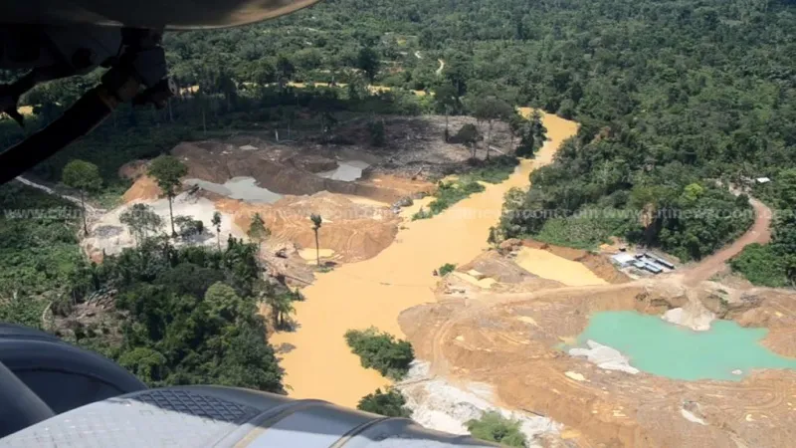
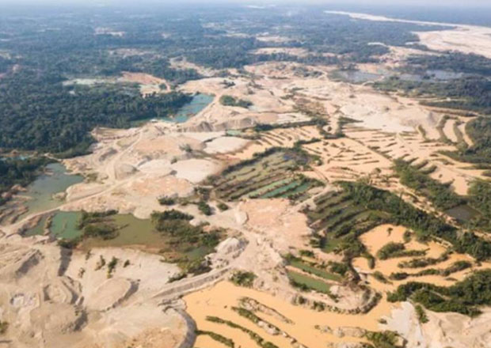
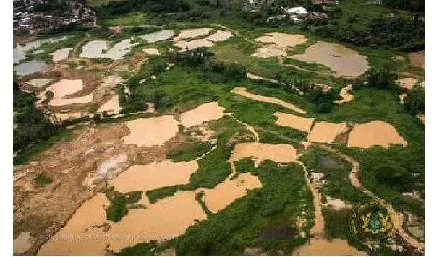
A threat to
Biodiversity
Many species of plants and animals are lost due to mining activities
Harmful toxins are released into the environment which makes it inconducive for native species to survive.
Figure 2: Land destroyed by illegal mining activities
6

Slide 7
Health Hazards
The heavy metals used in the extraction and processing of gold are toxic to human health.
The hand and foot nails of many of the operators are hardened, deformed or completely detached from the hands and feet (Figure 2). Respiratory tract infections are also common
Figure 2. Skin roseola resulting from arsenic intake/ingestion.
Source: Adu-Yeboah, J.K. and Obiri-Yeboah, D. Practical Social Studies for Senior High Schools. KwaDwoan Publishing, Accra. 2008
7

Slide 8

STATISTICS
80%
Exposure to mercury can cause kidney problems, respiratory, central nervous and cardiovascular systems disorders, loss of memory, psychosis, reproductive problems, and in some cases severe complications in children resulting in death.
of miners affected
8

Slide 9
A number of communities have seen rise in cost of living
Economic Implications
50
40
Wages or incomes of mine workers are used as a decider for goods and services in those communities neglecting the plight of the non-mine workers (i.e. government workers, farmers etc).
30
20
10
0
2001
2002
2002
2006
2008
9
Figure 3 Rise in cost of living in a period of 6 years

Slide 10




ADDRESSING THE
MENACE
CSIR-FORIG proposes the use of the Forest Landscape Restoration (FLR) approach as a long term measure.
This approach seeks to restore degraded landscapes such as mined sites by addressing socio-economic, ecological and environmental dimensions of reclaiming the degraded lands.
MITIGATION
10

Slide 11
CONCLUSION
Small-scale illegal mining in Ghana poses a significant menace to the environment, biodiversity, health, economy, and social fabric.
- Collaborative efforts from the government, communities, and international partners are necessary to combat this issue effectively.
11

Slide 12
References
Agbesinyale, P. (2003). Ghana’s gold rush and regional development: The case of the Wassa west district of Ghana. SPRING Research Series, 44. University of Dortmund, Germany.
Akabzaa, T. (2000). Boom and dislocation; the environmental and social impacts of mining in the Wassa west district of Ghana. TWN, Africa.
Akabzaa, T., & Darimani, A. (2001). „Impact of Mining Sector Investment in Ghana: A Study of the Tarkwa Mining Region‟, Draft Report Prepared for SAPRI.
12

